Slide 1
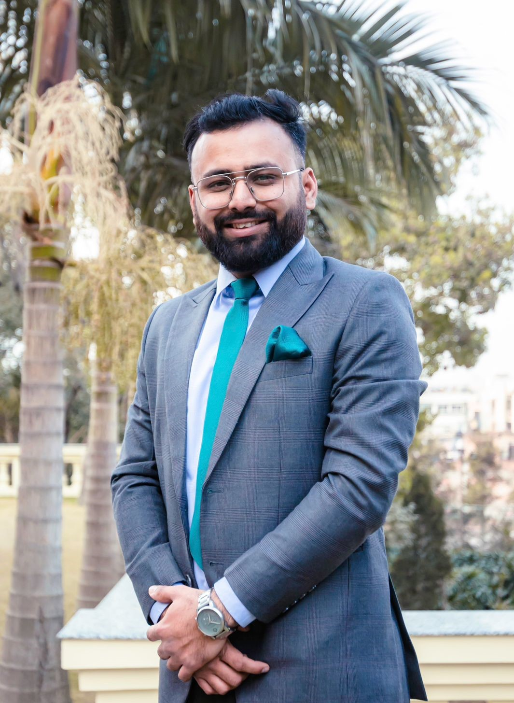
Sanam Sitoula Kathmandu,Nepal Ready to re-locate all over India
Sanam.ctaula@gmail.Com
+9779860793050
LinkedIn Profile ( CLICK HERE )
Experience Domains
Banking
Customer Relationship Management
Hospitality
Medical
Educational Institutions
Production and Manufacturing Plants

Slide 2
Summary
Having 7+ years of experience in different domains ( Hospitality, Medical , Banking and Customer Service ) and delivering enterprise-level applications and providing value to the clients from startups to corporate. I have a limited and humble specialization in software development team management & being extrovert in nature. I strongly believe that I can well understand the customer needs and given appropriate motivation, time and resource, I can do anything

Slide 3
Work Experience
Role: Project Manager - ERP
Company Name: Janak Education Materials Company Limited (Click Here)
Company Profile: Production and Manufacturing company which aim is to provide qualitative study material in digital and physical form at an affordable price to the students of every nook and corner of the nation.
Duration: April 2022 – Present
Job Description
Preparing the ICT framework for overall managerial work in the organization
Providing training to managerial staff regarding different applications
Overlook all the organization application and fix the issues if arises
Implement the business logic in the applications doing business reengineering
Preparing report based on different department requirements

Slide 4
Work Experience
Role: Digital Banking Associate
Company Name: Nepal Bank limited (Click Here)
Duration: Jun 2020 –March 2022
Company Profile: Nepal Bank Limited (NBL) , the first bank of Nepal which aim is to collaborates with its customers while designing, developing, and delivering banking solutions to satisfy the interest of all stakeholders by efficiently leveraging cutting-edge technology.
Job Description
Worked closely with all the stake holder and ensure the digital product like ( Mobile application, E-banking , Online Account , Demat Application , APIMIS ) are working smoothly
Coordinating with marketing team and launching different campaign which overall increase the digital business of bank
Identifying, Testing and implementing the new digital products which are required by different departments in bank
Assisting branch, province level staff and customers if needed
Preparing proper SOP in department Managing and implementing projects like ( BankXP , Fonepay QR, Job in Mobile Applications)
Identifying the new digital market place to expand the business of organization and ease operating procedure with the help of technologies

Slide 5
Work Experience
Role: Project Manager
Company Name: AnalogueInc Nepal (Click Here)
Duration: Jan 2020 – June 2020 (Contract)
Company Profile: Start-ups software and digital marketing company which aim is to provide be the one-stop destination for upgrading business to the next level.
Job Description
Worked in project like HoppersPass( Travel Based ) , Scholarkey ( SchoolERP) ,LeoSquad (Task Management)
Developed a detailed project plan to monitor and track progress
Manage changes to the project scope and project schedule
Perform risk management to minimize project risks Assign the job and assist the developer accordingly
Allocate task to developer team using clickup, trello and asana

Slide 6
Work Experience
Role: Sales and Marketing Officer
Company Name: Danfe Solution Pvt. Ltd. (Click Here)
Duration: 12/2018 - 12/2019
Company Profile: Hospitality industry company which aim is to provide specifically designed software to fulfill the needs of the hospitality industry
Job Description
Worked in hospitality sector of Nepal and developing relationship and conducting sales operations
conducted the survey for identifying proper need assessment of hospitality business
Manage the team and guide them accordingly to mobilize them in right path
Became the closer and close the deal when needed.

Slide 7
Work Experience
Role: Business Consultant(Part-time)
Company Name: Cybernetics Pvt.Ltd (Click Here)
Duration: 01/2019 - 02/2019
Company Profile: Company currently focusing in major fronts of Internet Management Solution, (IoT) Internet of Things, ICT Base Remote monitoring and configuration for any platform, Smart Bus Solution, Networking Solution Provider, and telecommunication services provided by Nepal Telecom
Job Description
Worked towards hospital and bank domain for the product like QUEUEBEE and Digital Information Desk
Maintained the good relations with existing customers
Directly visiting the places and showed on-spot demo sessions
Identified the feasible area of the project in government sector and approached them
Maintained the smooth relations with government individuals and departments Identifying the core market for the SMART BUS Project and mobilize team accordingly.

Slide 8
Work Experience
Role: Junior Software Developer
Company Name: Percoid IT Solutions (Click Here)
Duration: 06/2018 - 10/2018
Company Profile: Percoid IT Solutions is an exclusive offshore development center for BillboardPlanet, LLC., a leading provider of media management solutions for the Out-of-Home Industry.
Job Description
Basic Knowledge of AngularJS.
Web API concept in Core 1.0 and 2.0
Understanding of OWIN ,Claims and Principle
Used these skills in Project 'Quantum' (BillBoard Management Application used by JCDecaux)

Slide 9
Work Experience
Role: Junior Software Developer
Company Name: Percoid IT Solutions (Click Here)
Duration: 06/2018 - 10/2018
Company Profile: Percoid IT Solutions is an exclusive offshore development center for BillboardPlanet, LLC., a leading provider of media management solutions for the Out-of-Home Industry.
Job Description
Basic Knowledge of AngularJS.
Web API concept in Core 1.0 and 2.0
Understanding of OWIN ,Claims and Principle
Used these skills in Project 'Quantum' (BillBoard Management Application used by JCDecaux)

Slide 10
Work Experience
Role: Implementation/Support Engineer
Company Name: MixERP Inc Pvt. Ltd. (Click Here)
Duration: 02/2016 - 05/2018
Company Profile: A software developer company focus on open source ERP application.
Job Description
Worked with senior stakeholder to develop the new product line and approach market accordingly
Worked towards increasing product awareness and the usage of product BANQSYS : Cooperative Core Banking Solutions by adopting measures such as on-spot demo, office visits, online marketing, online demo sessions and so on
Identified opportunities for further sales and new areas for development through detailed research of the Computer hardware and software industry.
Provided pre-sales support to partners for customer visits and presentations; built capacity for channel partners
Prepare the SQL queries to generate the report needed for stakeholders

Slide 11
Familiar Technologies and Appliction
Bank Domain
PumoriIV, BankSmartV5, ExpressBank, NBL API System, Fonepay Merchant and Bank Application
CRM
Zoho Hubspot, Asana
Database
PostGRES, MSSQL, MYSQL
Designing tools
Adobe Photoshop
Server Side Scripting
Asp Dot Net, PHP
Client Side Scripting
JavaScript & JQuery ,AngularJS
Other Applications
Tally V9 ( Accounting) , SaralBilling (Accouting) , Banqsys ( Cooperative) , Restro Order and
Hotel Simplify ( Hospitality Industry), Bidhee ERP ( Procurement and Store ), MixERP (HR,Manufacturing,Production,Sales and Purchase)

Slide 12
Professional Skills
Education
Master's Degree in Public Administration
Public Administration Campus (Tribhuvan University )
2023-2025
Master's Degree in Economics
Ratna Rajya Laxmi Campus (Tribhuvan University)
2019-2022
Bachelor's in Computer Information System
Apex College( Pokhara University)
2013-2017
Training : Employability Skills ( 9th & 10th Feb,2017)
Workshop : College to Corporate ( 15th & 16th Aug,2017)
Extrovert
Negotiating
Problem Solving
Leadership
Team Management
Communication
Market Analysis
Business Analysis
Languages
English
Nepali
Hindi

Slide 13
Most Proud of
MixERP Business ERP Solution
A blend of minimalist design and powerful ERP apps & modules and been part of the team
Bhrikuty- A Platform for learner
A content based E-learning platform
Passion About
Startups, New technologies, DeFI(Decentralized Finance) Blockchain, Teaching, Collaboration and Contributions

Slide 14
Sanam.ctaula@gmail.Com
+9779860793050
LinkedIn Profile ( CLICK HERE )
Thankyou for screening my profile.
Feel free to contact me if we can contribute together in order to achieve common organizational goals.

